Slide 1
GLANG (GAME LANGUAGE)
Name : Trivedi Jaimish
Roll no. : IT119
Clg ID : 17ITUOS082
Name : Trivedi Foram
Roll no. : IT118
Clg ID : 17ITUOS044
Guided By Prof. Roshni Raval

Slide 2
Features of language
Our platform provides you simple and concise game management features combined into single application and having multiple features ranging from playing any game, to adding or removing them from the application.
One can install, uninstall, play and close games as well as swap from one running game to another running game.
Also in the backend to handle the game management, we have provision of 3 separate lists which are mainly, running list, available list and installed list.
One can see the list of games that are available, detailed list of games that are installed in which size and cache information is also provided. List of games that are running in the system can also be seen.
For the memory management related to the games, we have also provided certain features like displaying total storage and cache of games , clearing RAM and clearing cache of particular game.
At any instance of time, if you need help regarding the application, you may enter command get help for all the information of any command.

Slide 3
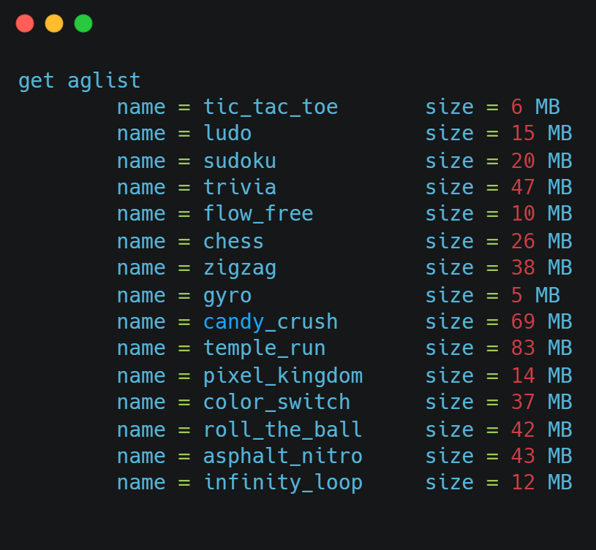
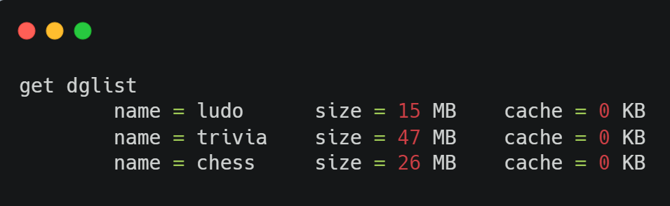
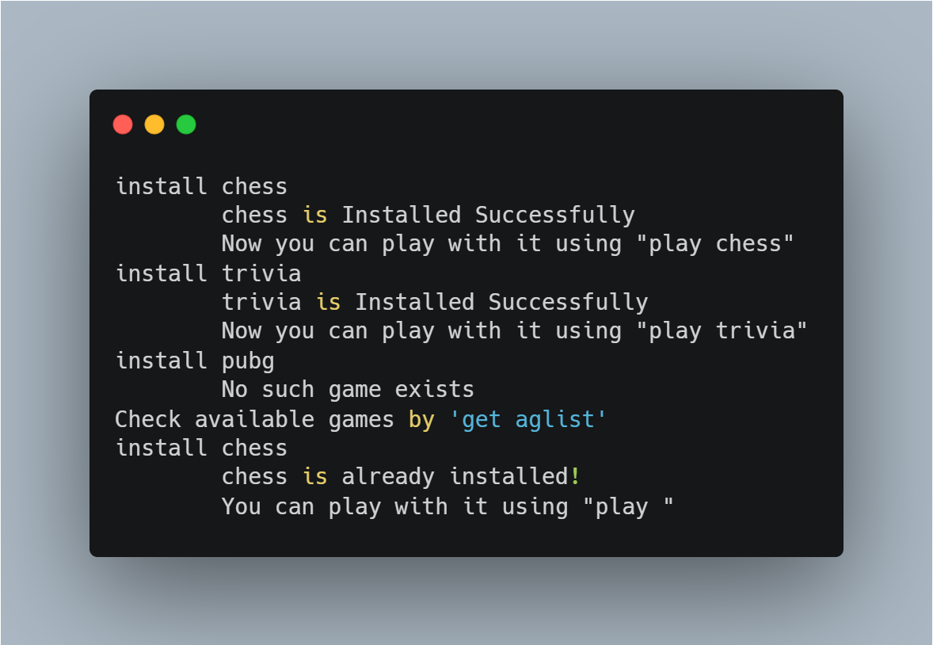
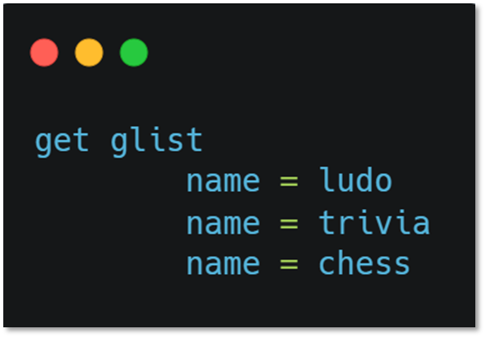
Input/ Output of the language
List of Available Games
Detailed List of Installed Games
Installing Games
List of Installed Games

Slide 4
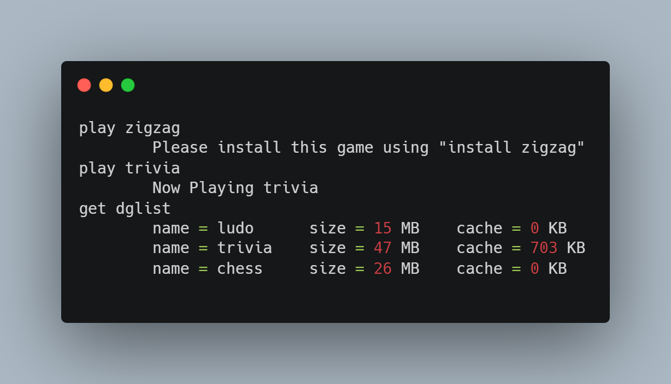
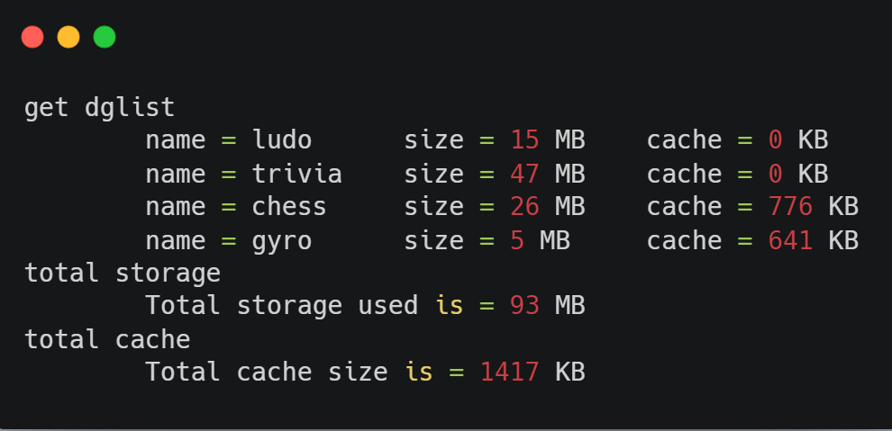
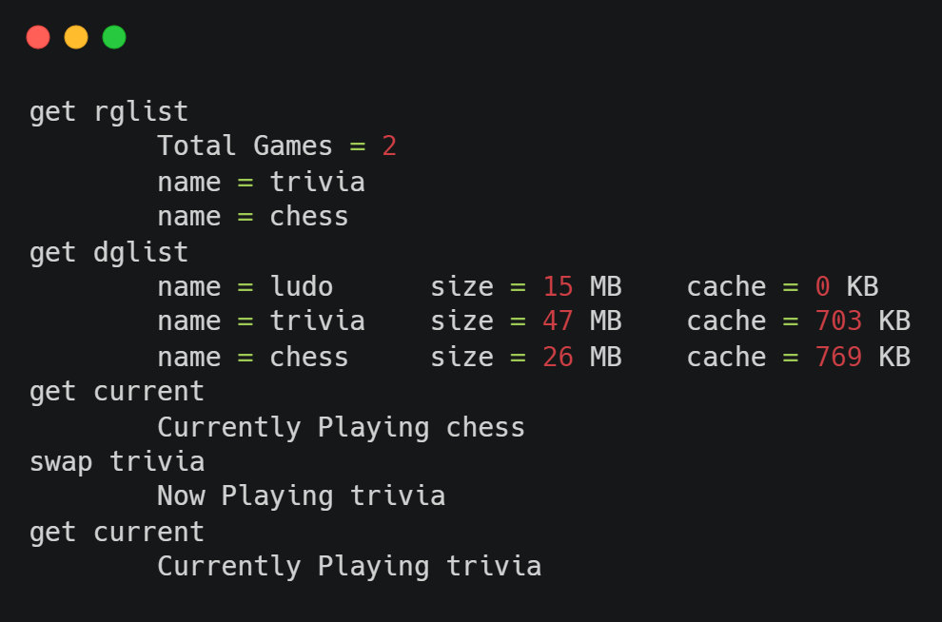
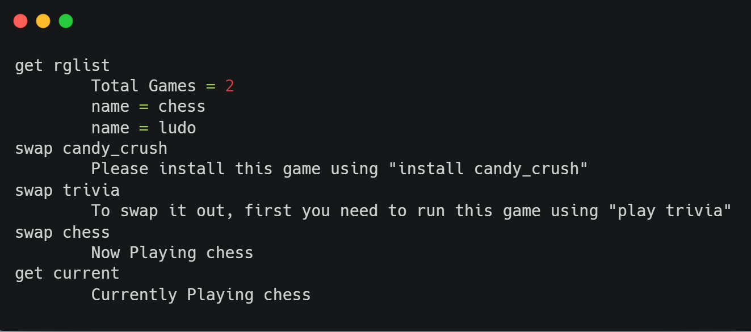
Input/ Output of the language
Play Games
Total Storage And Cache
Close Games
Swap between Games

Slide 5
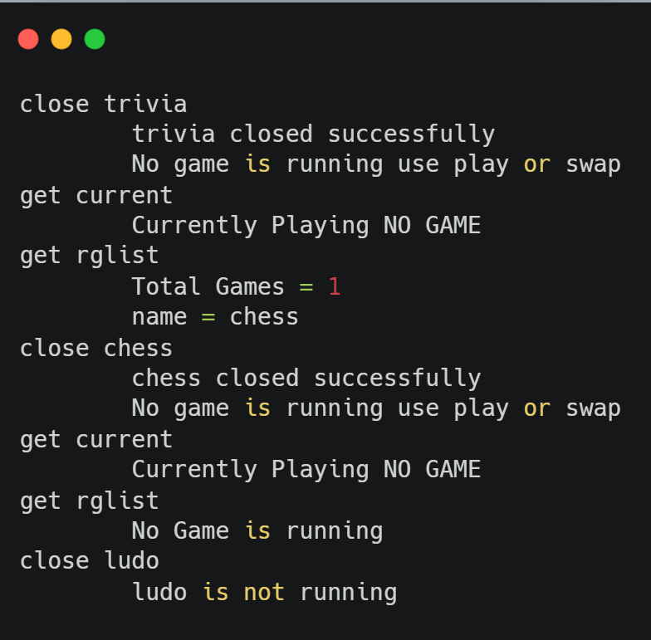
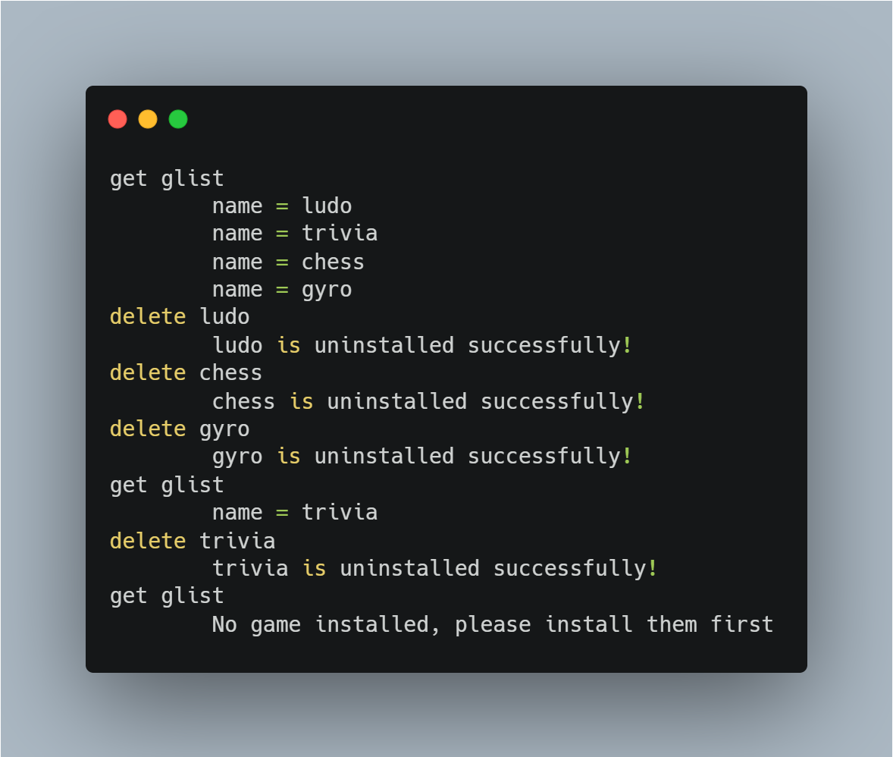
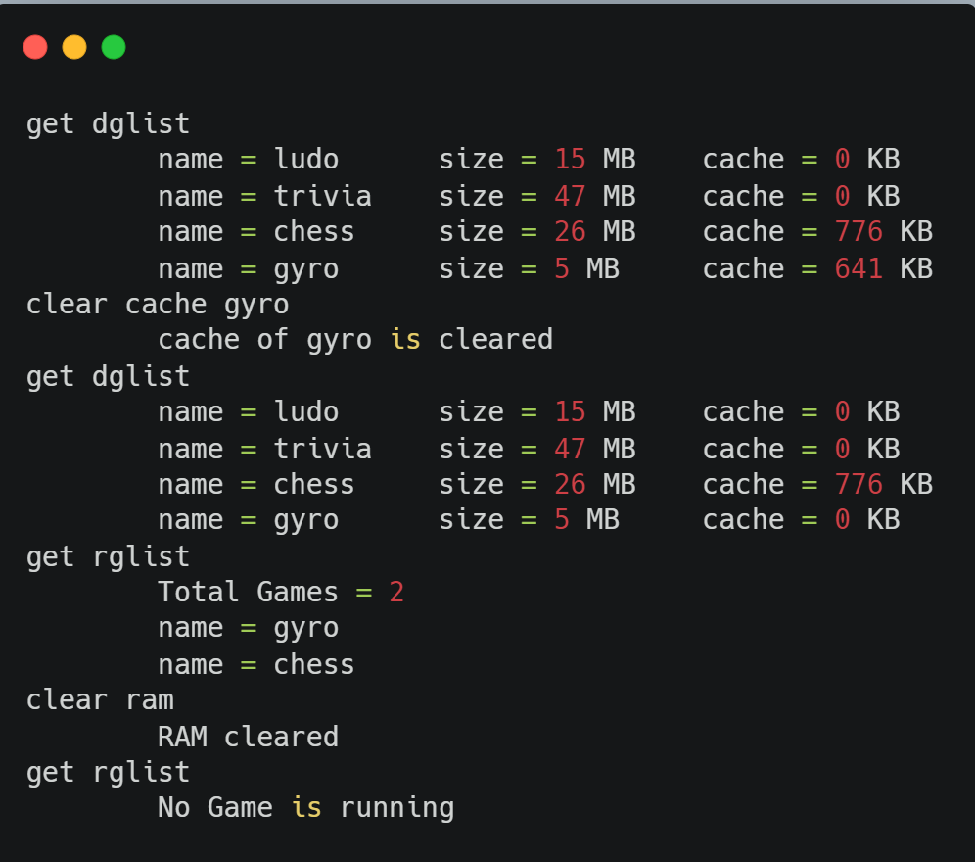
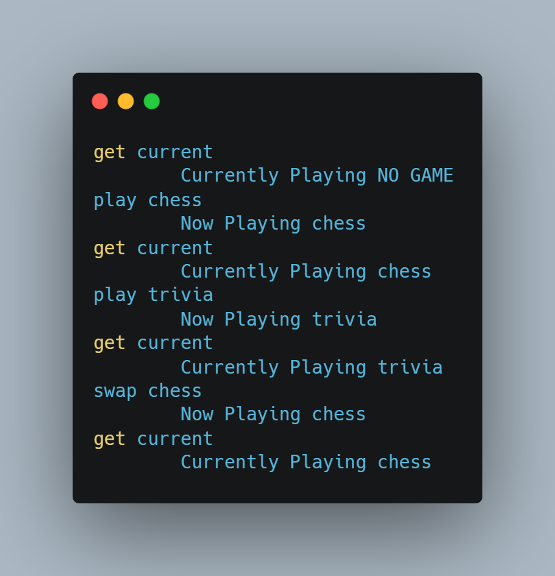
Input/ Output of the language
Running Games List
Deleting/uninstalling games
Clearing cache and RAM
Current Game

Slide 6
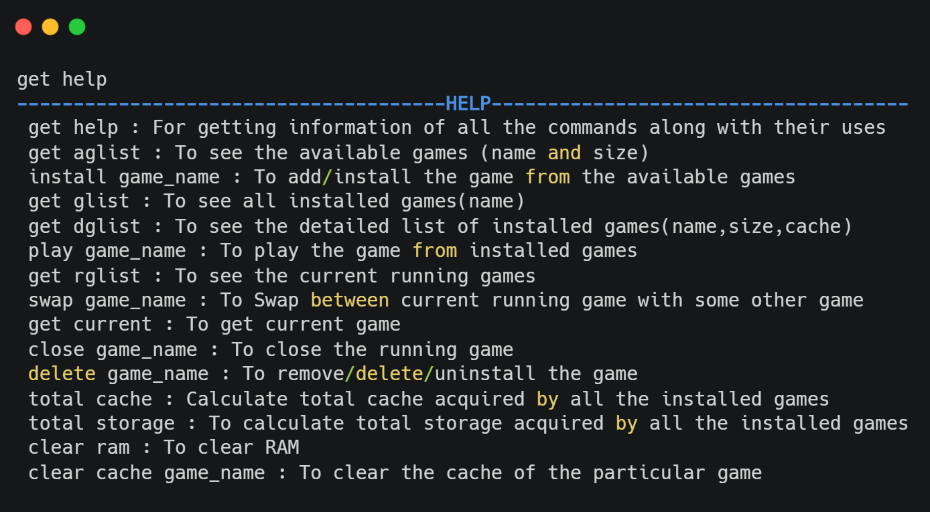
Input/ Output of the language
Getting Help

